Slide 1

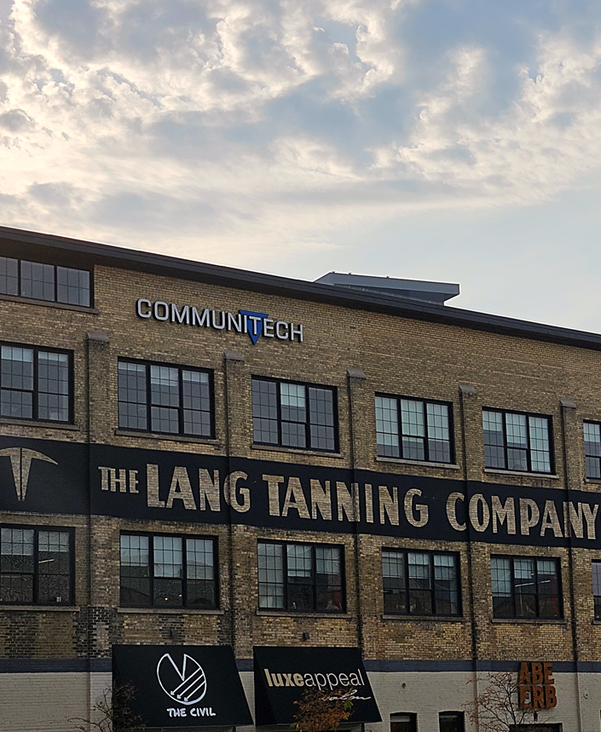

TERM REVIEW
Ava Marie Schmalz
April 20, 2026

Slide 2
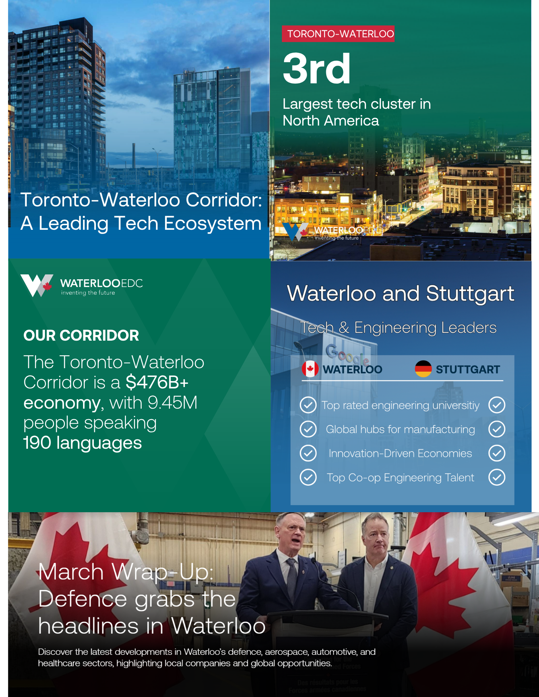
OVERVIEW OF TASKS
Netherlands term project
Wrote and published blogs (Monthly wrap-ups, AI Hubs, Clean Tech, R&D Hubs and more)
City Comparison Graphic (Stuttgart)
Lead scoring in HubSpot
Created social media graphics (comparison stats, testimonials, carousels)
Created Canva videos (Waterloo at a Glance and stat video template)
Selected top co-op applicants and conducted interviews
Onboarding with the next co-op
Random Excel Tasks
Attended Bio Hub tour with the BD team
HubSpot Training (Inbound Marketing and Content Marketing)

Slide 3

Netherlands Campaign
STEP 1
STEP 2
STEP 3
STEP 4
STEP 5
Researched the Netherlands and aligned their needs with Waterloo’s strengths
Identify and select relevant content to repurpose
Develop LinkedIn captions
Build and launch LinkedIn ads
Monitored performance metrics
waterlooedc.ca
3

Slide 4
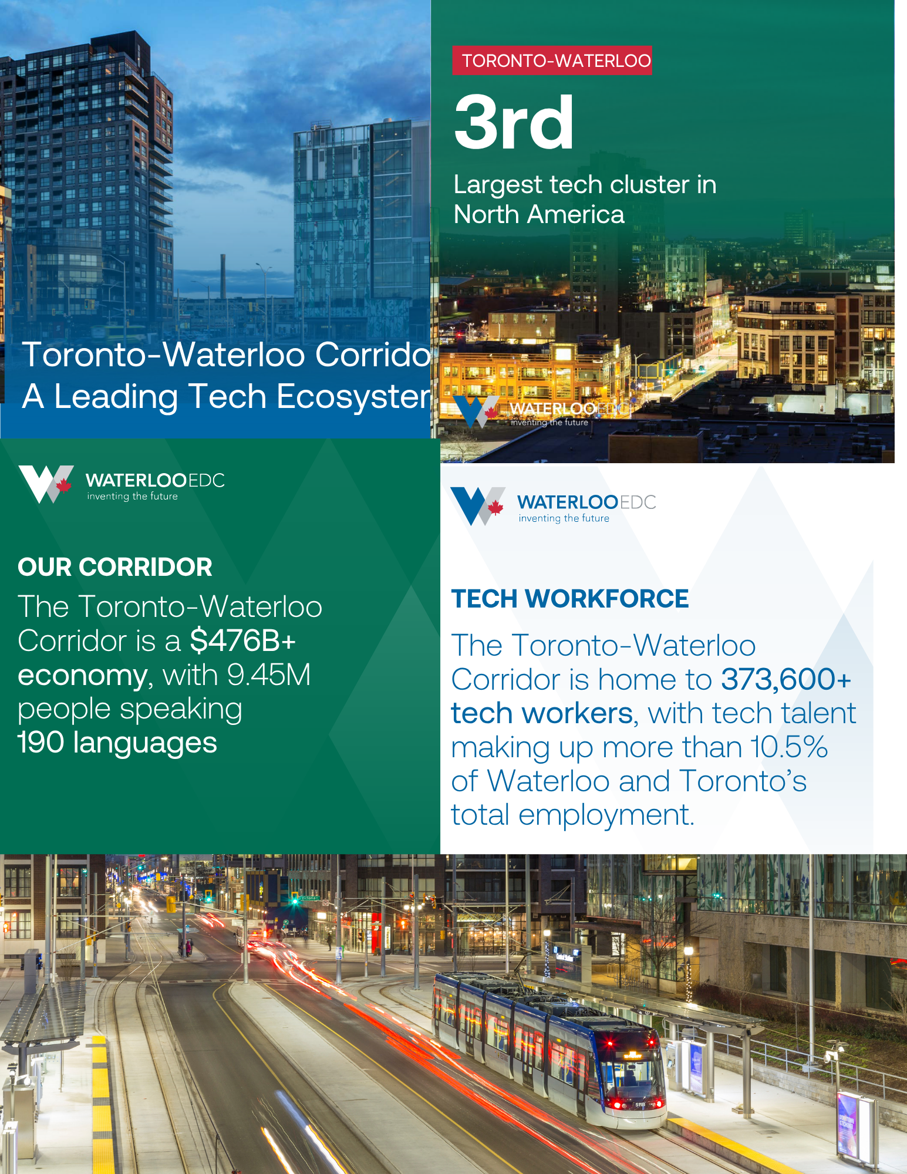
PROJECT GOALS
Explain why Waterloo is an ideal location for companies currently based in the Netherlands by showcasing its talent, technology and manufacturing ecosystem, R&D capabilities, and innovation opportunities.
Build brand awareness and communicate the strengths of our ecosystem to companies in the Netherlands.
Evaluate how different types of ad content perform in the Netherlands (blogs, videos, carousels, and single-image graphics).
Learn how LinkedIn ads work and how to set them up and manage them effectively.

Slide 5
Strengthen visibility among Dutch companies
Dutch companies
Research
Netherlands Market
Key Insights:
Opportunity to expand brand awareness in the Netherlands
  Increase recognition of Waterloo as a leading business and innovation hub
  Strengthen visibility among Dutch companies
Strong alignment with key industries
  Significant focus on advanced manufacturing and technology
Takeaway:
Expanding brand awareness and clearly positioning Waterloo’s strengths in technology, manufacturing and talent will help attract and engage companies from the Netherlands.
Thank you to the previous co-op for their contributions to this research.

Slide 6
Content Used
All Companies:
Video: Waterloo: Virtual Ecosystem Tour
Blog: Waterloo Rockets into Top-10 of CBRE Tech Talent Rankings
Testimonial: OVHcloud
Carousel: The Toronto-Waterloo Corridor
Manufacturing:
Video: Why Waterloo is a Global Hub for Manufacturing Automation
Technology:
Video: Waterloo: Leading in Quantum, Fintech, AI and More

Slide 7
Performance Metrics
Ad Set Name | Total Spent | Impressions | Clicks | Click Through Rate | Video Views
Tech/Quantum/AI Video | 1000 | 28151 | 54 | 0.192% | 14065
Manufacturing Automation Video | 1000 | 26736 | 62 | 0.232% | 11947
Virtual Ecosystem | 2000 | 54996 | 113 | 0.205% | 28688
OVHcloud Testimonial | 1000 | 52747 | 38 | 0.072%
CBRE Top Ten | 1000 | 51035 | 24 | 0.047%
TWC Carousel | 1000 | 40440 | 19 | 0.047%

Slide 8
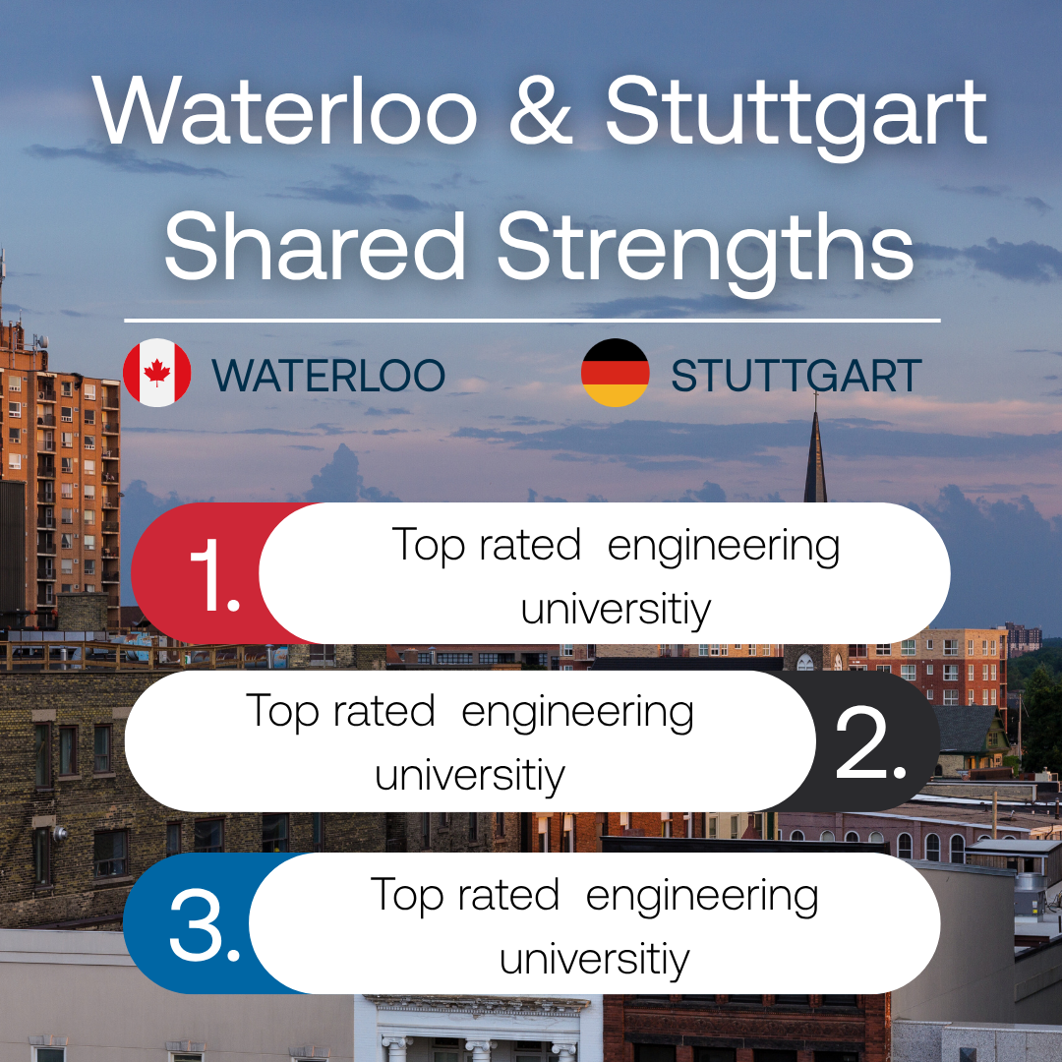
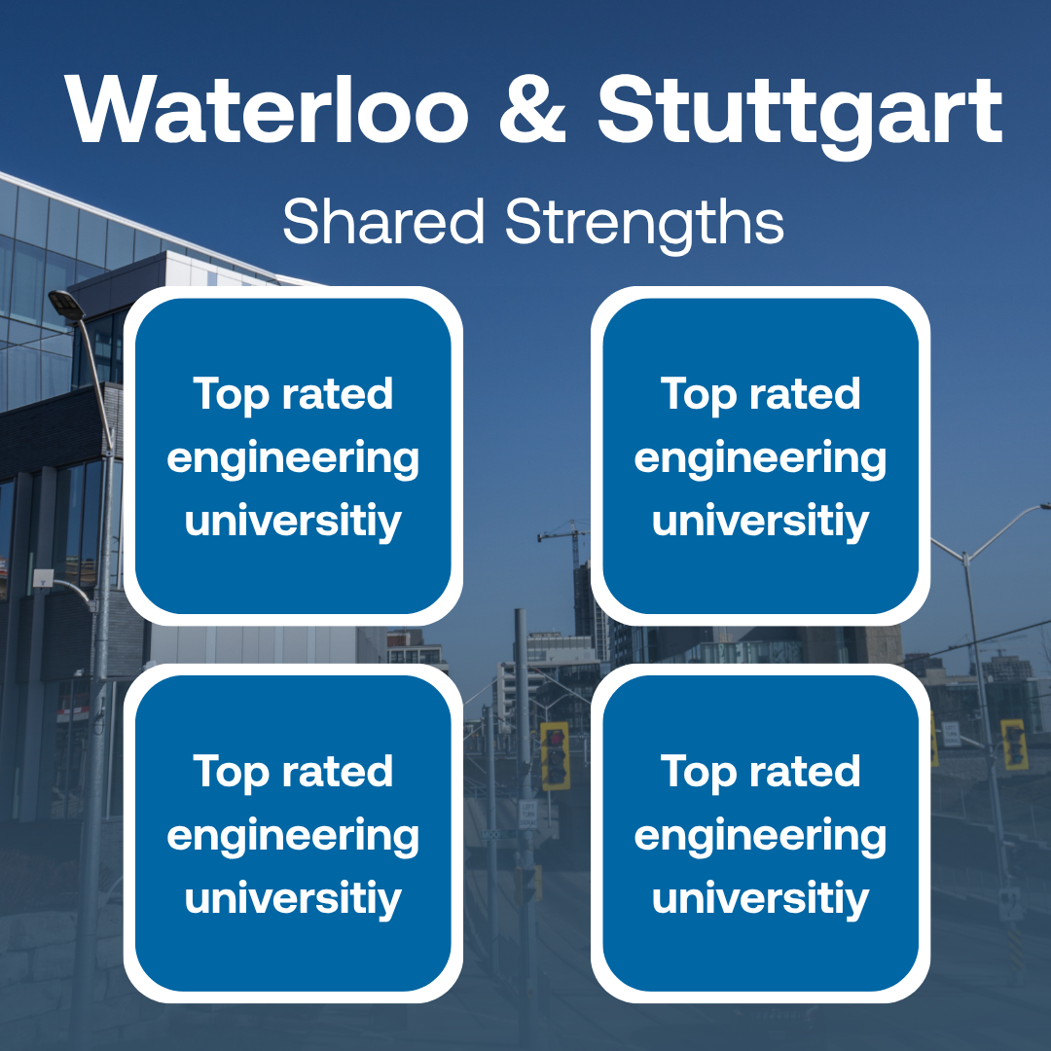
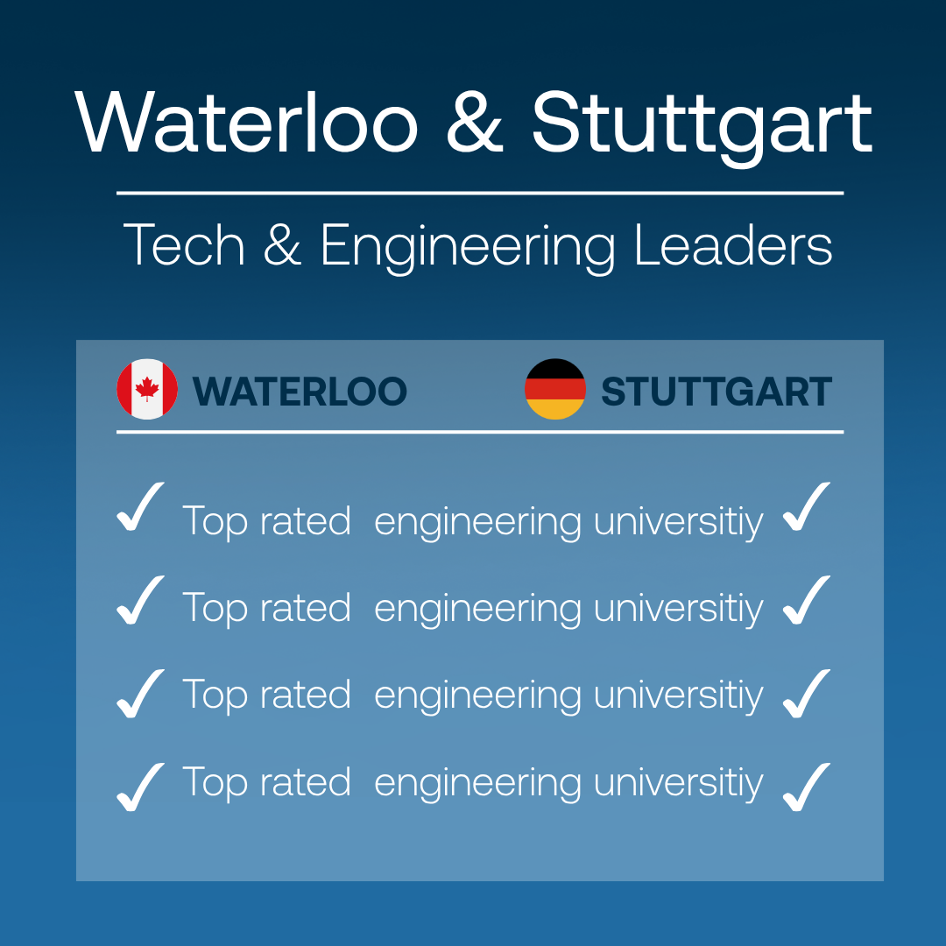
City Comparison Graphic - Ideas
waterlooedc.ca
8

Slide 9
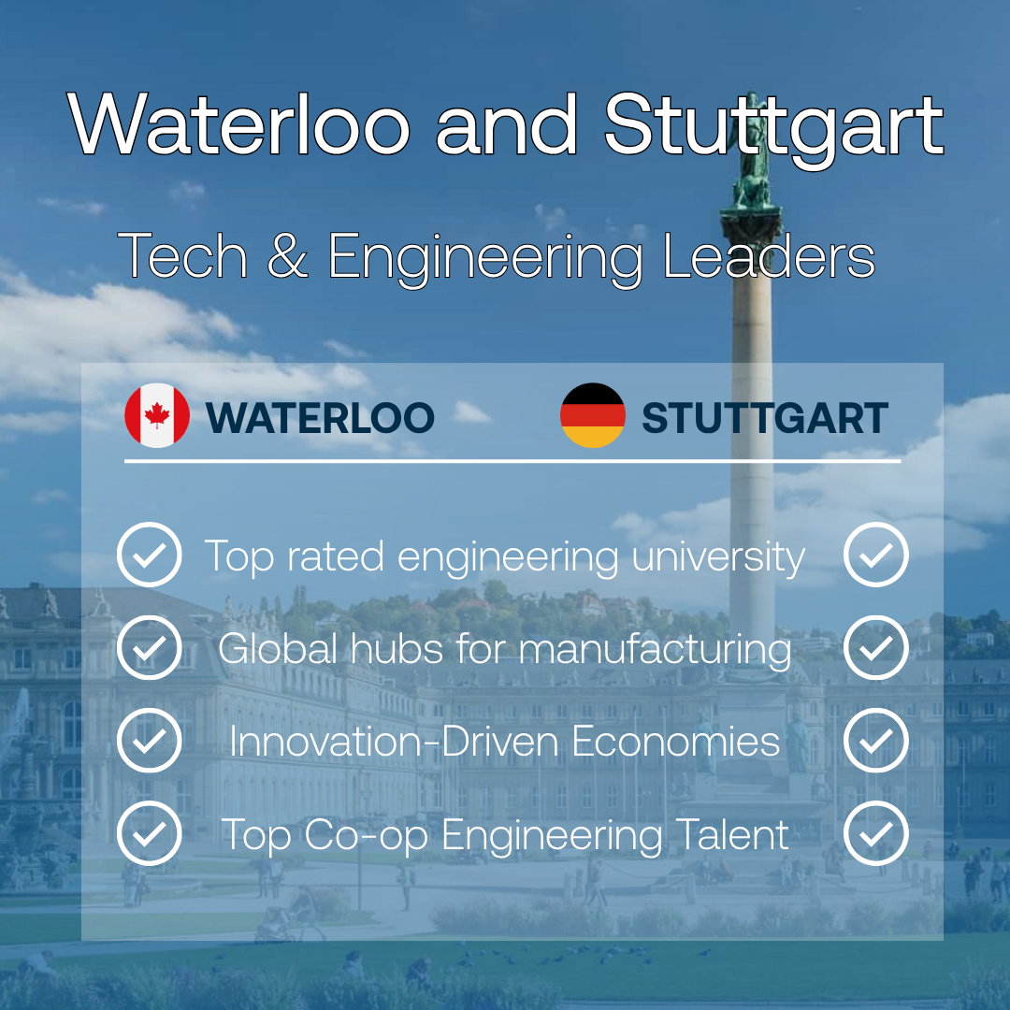
City Comparison Graphic – Final Draft
Goals:
Compare Waterloo to a similar global city to show competitiveness
Highlight key similarities (talent, tech, innovation, manufacturing)
Position Waterloo as a strong alternative to major hubs
Next Steps:
Recreate the design in InDesign
Create a LinkedIn post for Maria
Monitor performance metrics (Next Co-op/ Eamon)
waterlooedc.ca
9

Slide 10
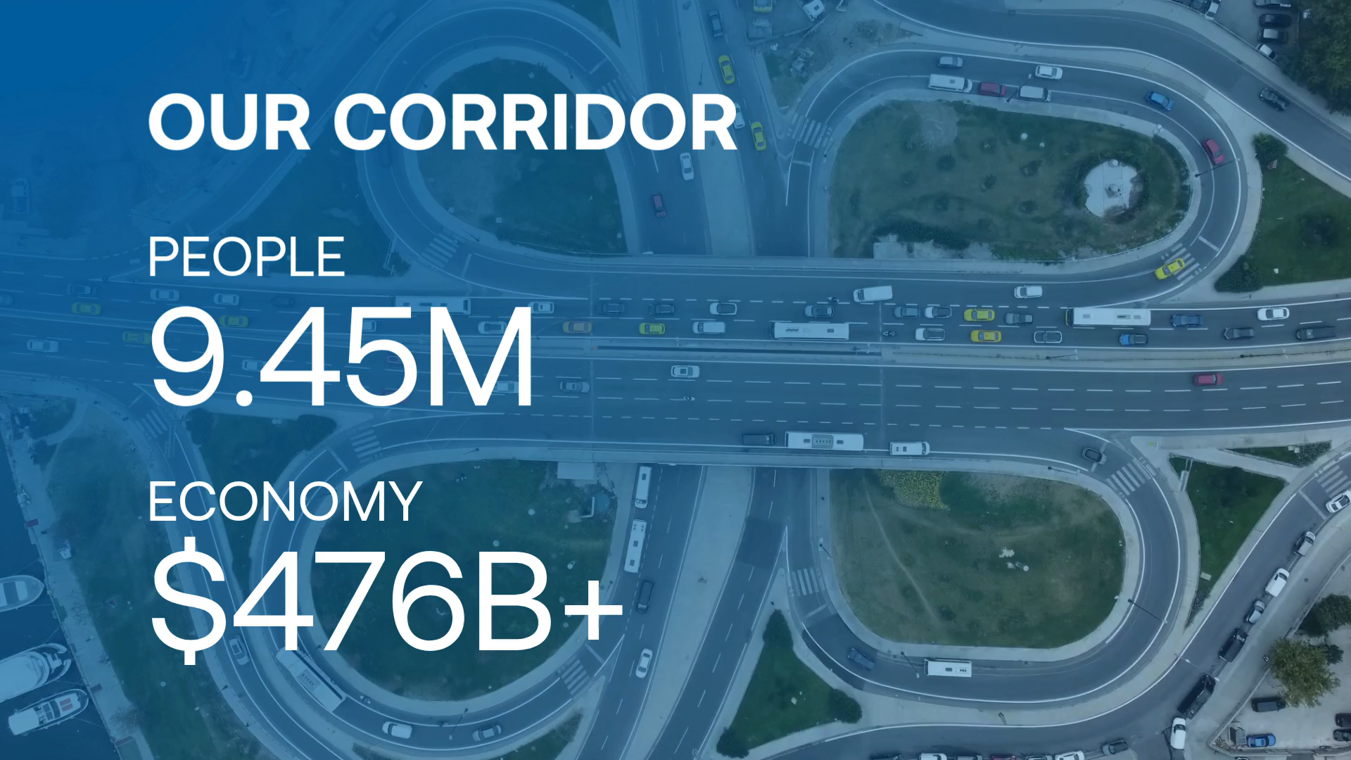
Statistic Video
Goals:
Create a more visually engaging way to present statistics and increase engagement.
Provide more options for comparing statistics
Allow for greater creativity in designing statistic graphics

Slide 11
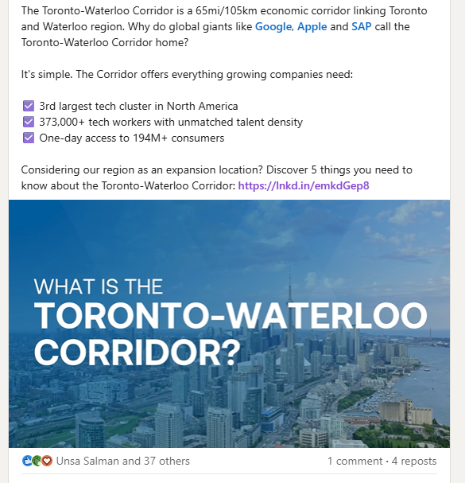
Statistic Video – Performance
Engagement:
Strong performance for a non-carousel format
1,241 impressions generated solid reach
High engagement rate (11%) indicates strong audience interest
38 reactions show positive interaction
94 clicks

Slide 12


Social Graphics
Research and Development:
34.1% engagement rate
32.8% click-through-rate
Waterloo’s Quantum Ecosystem:
1,537 impressions
372 clicks
24.2% click through rate
26.35% engagement rate
waterlooedc.ca
12

Slide 13
Social Graphics (For Jude)
Social Graphic | Number of Times Used
BD Event Graphic | 5
Statistic - New | 5
Cover | 5
Blog Cover | 1
Statistic | 6
Statement | 6
Testimonial | 4
End slide | 6
Statement - New | 2
waterlooedc.ca
13

Slide 14
Ideas
Blog about co-op, from a co-op student: A student-written blog sharing co-op success stories, including both the company and student perspective, with collaboration from the University of Waterloo or employers.
City comparison webpage (like the tech talent calculator): An interactive tool to easily compare Waterloo with other cities, with quick notes highlighting key differences.
Audio blog posts: Turn blogs into audio for accessibility; can be AI or voice recorded and managed by future co-op students.
Instagram: A minimal Instagram presence with a few posts explaining what we do and directing users to LinkedIn.
Co-op video about talent and co-op: A short video showing the co-op experience from the company perspective, featuring multiple employers and students.

Slide 15
THANK YOU FOR A GREAT TERM!
This has been such a valuable experience
Reach out anytime!
Amschmal@uwaterloo.ca | avaschmalz.com | www.linkedin.com/in/ava-marie-schmalz
waterlooedc.ca
15

Slide 16


